Slide 1
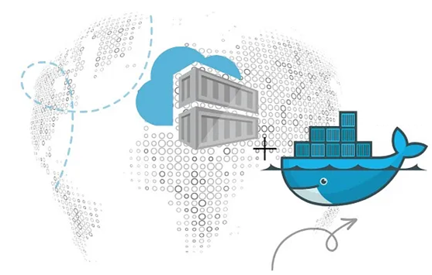
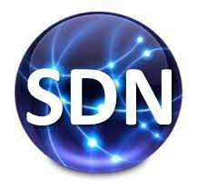
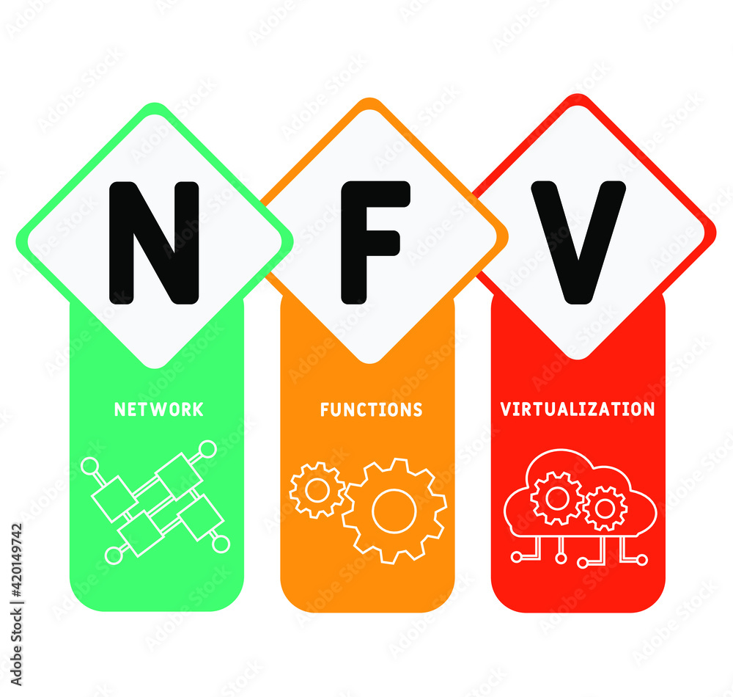
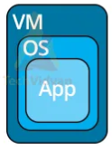
PDS
Computer Vision
Chapter 2
IoT Ecosystem
Part 1-2
https://github.com/siagianp
https://www.youtube.com/@AmelOline/videos
https://github.com/amelcharolinesgn2/IoT_simulator-mqtt-NodeRed
https://github.com/amelcharolinesgn2/Cloud-Infrastructures
https://github.com/amelcharolinesgn2/ClouD-Infrastructure-SISKA-2025
https://github.com/amelcharolinesgn2/IoT_app-and-Modules
Notes:
https://www.mi.fu-berlin.de/inf/groups/ag-tech/teaching/2012-13_WS/L_19528_Embedded_Internet_and_the_Internet_of_Things/08.pdf
https://www.hivemq.com/blog/mqtt-vs-coap-for-iot/

Slide 2
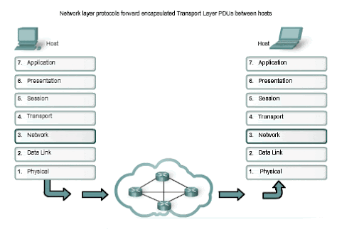
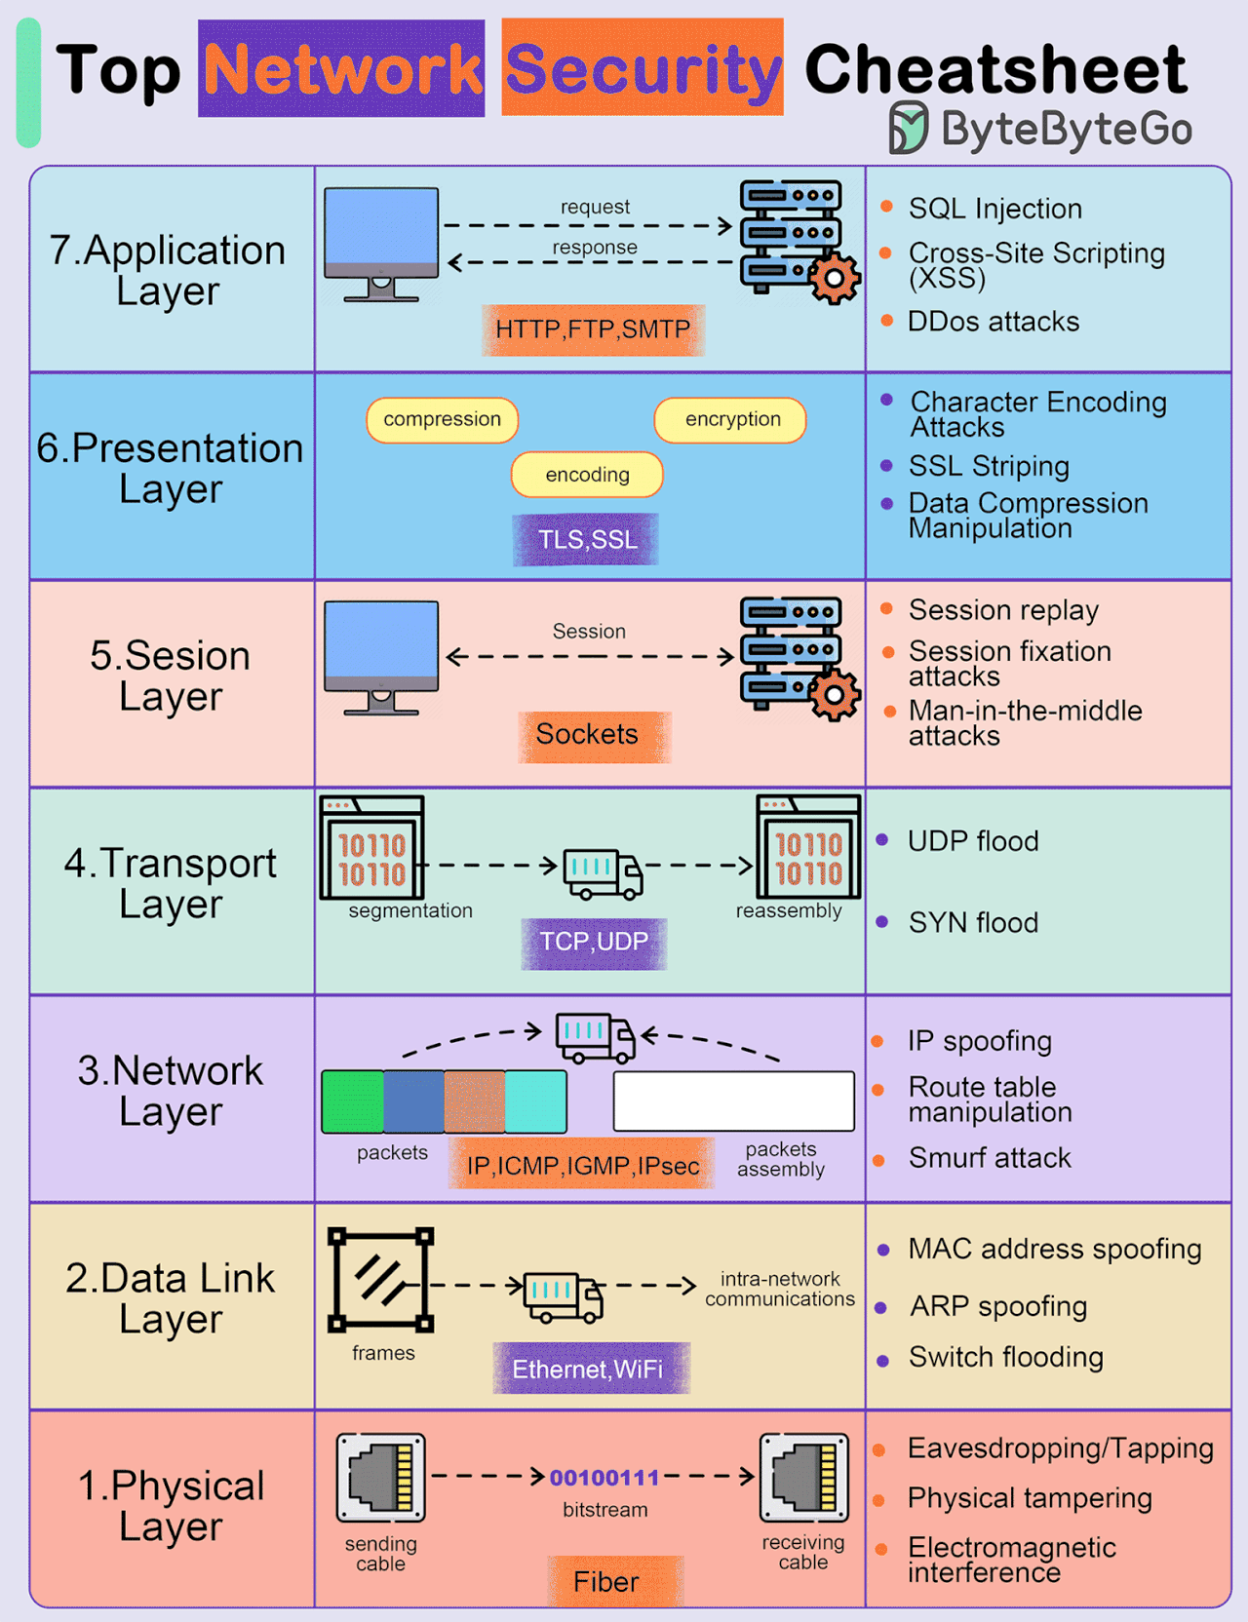
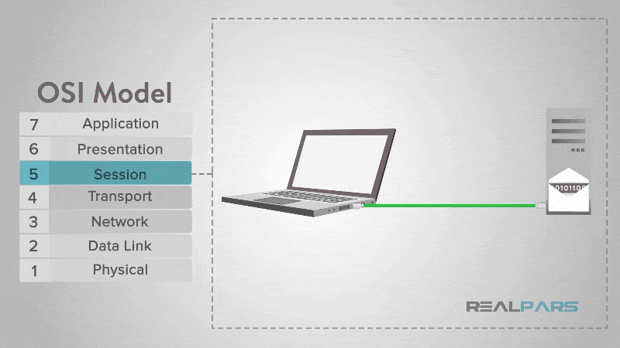
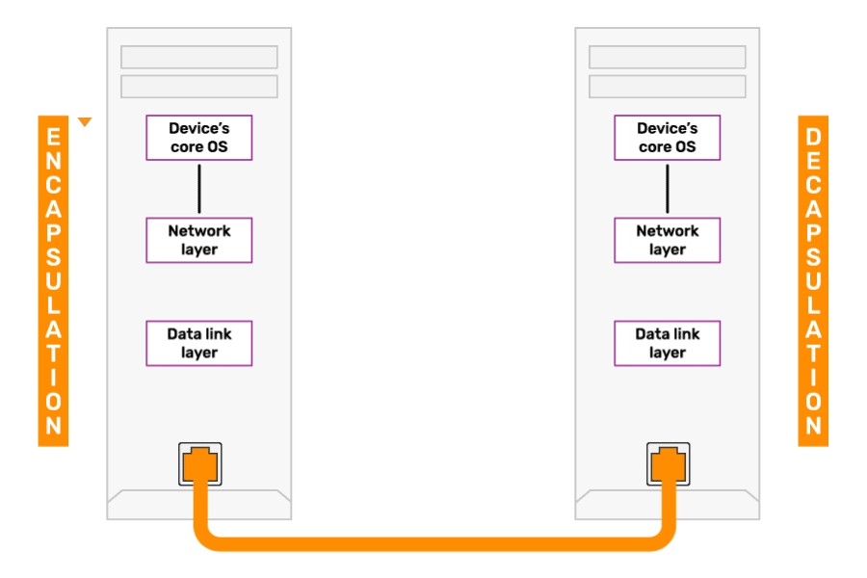
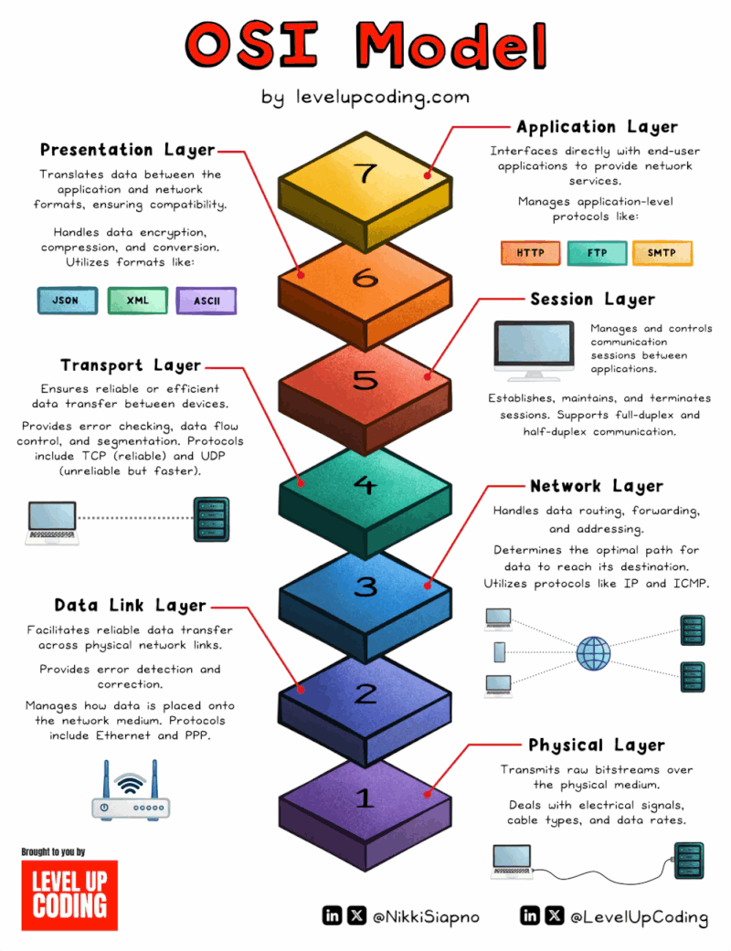
4
Communication Technology Of IoT
The IoT Ecosystem: Sensor Device &Components, Architecture, Communication Technologies, and Protocols
Network & Communication
Notes:
OSI model: 7 layers of network communication | Networkat posted on
EP97: 10 Good Coding Principles to Improve Code Quality

Slide 3
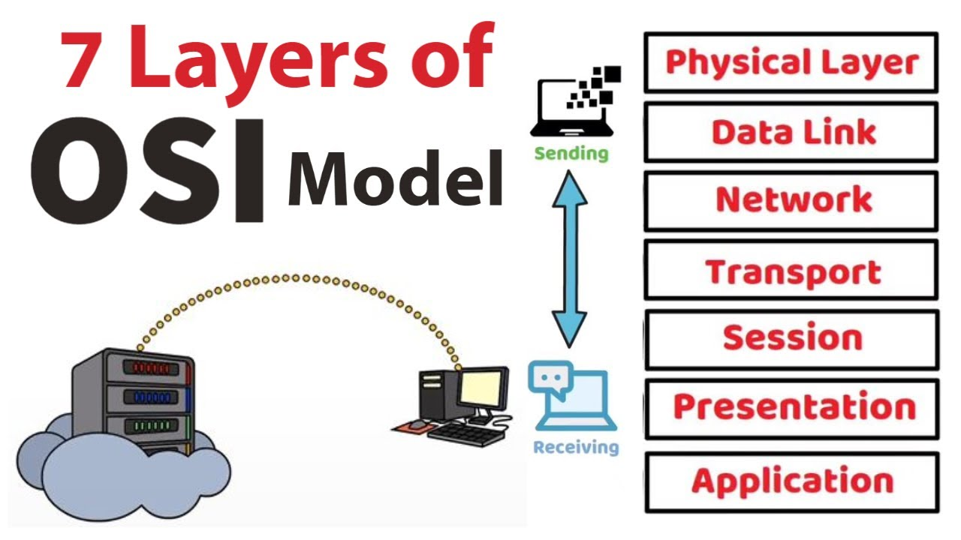
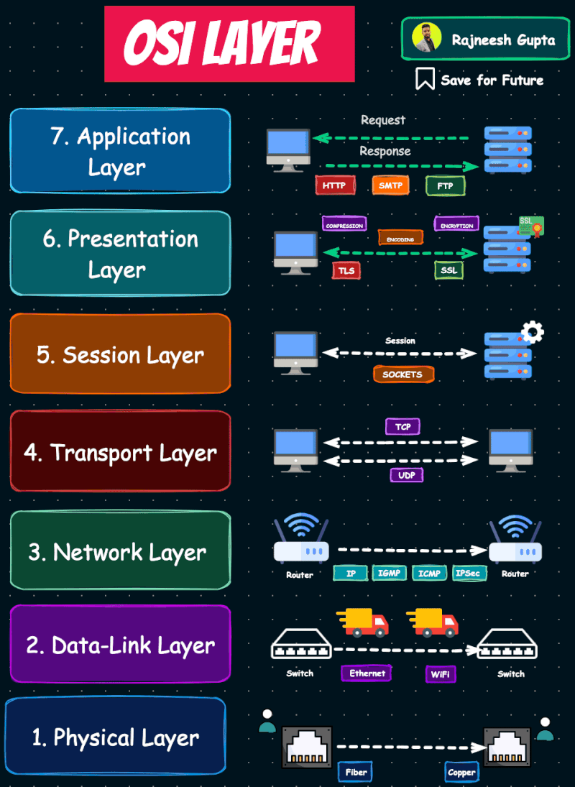
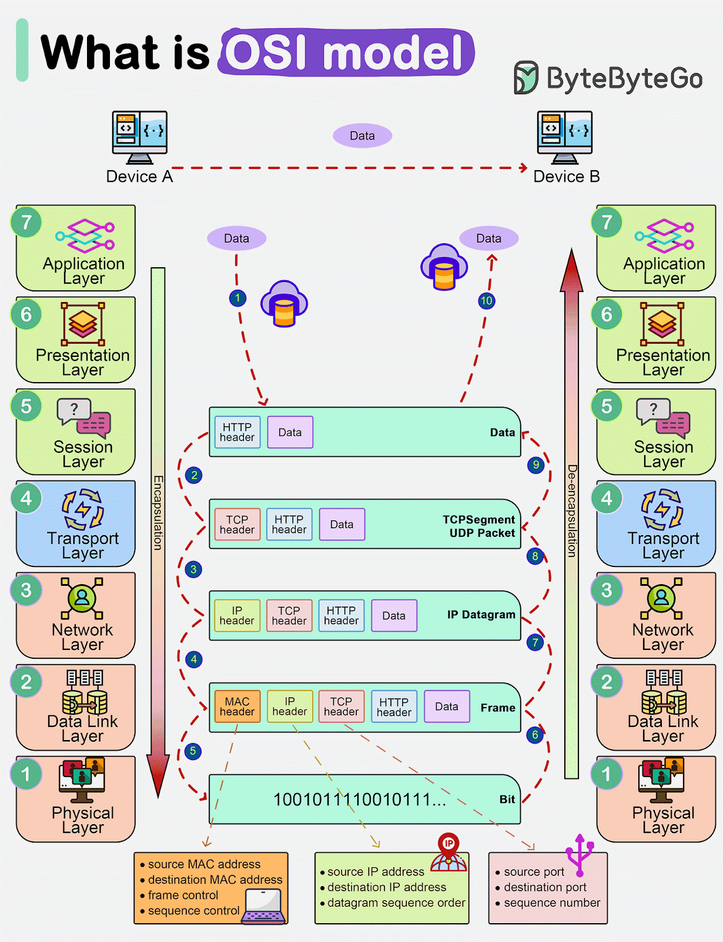
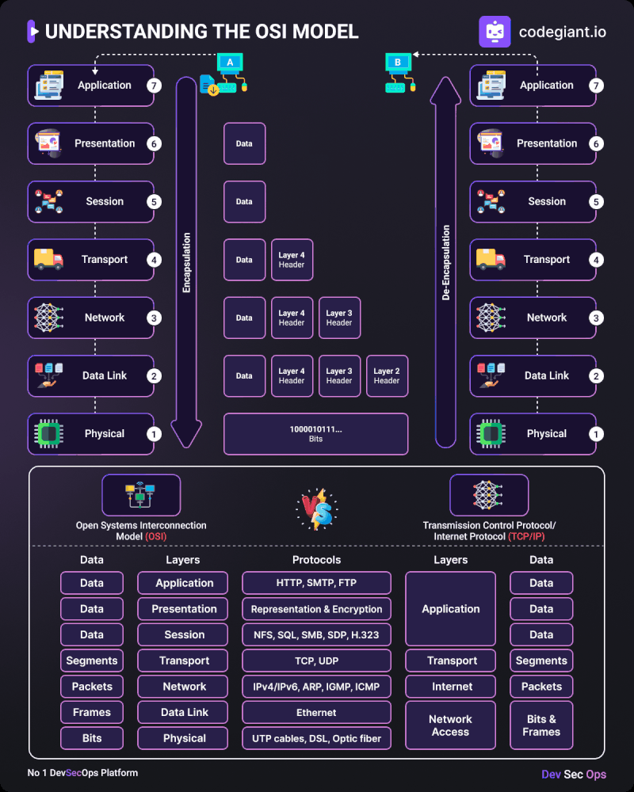
Communication Technology Of IoT (Cont’s)
Network & Communication
OSI Model
Notes:
https://in.pinterest.com/pin/9570217952435876/
https://www-coengoedegebure-com.translate.goog/osi-model/?_x_tr_sl=en&_x_tr_tl=id&_x_tr_hl=id&_x_tr_pto=imgs
https://www.google.com/imgres?imgurl=https%3A%2F%2Fyt3.ggpht.com%2FXeQn7VFKWDToPbww4f5uY_AMkrr1n91hR6fSi8XFtGuc1g3f3ayBE5ezhQFG5MMcd21CJd0a9AZDjQ%3Ds1600-nd-v1&tbnid=o3WVk6YZvzwuwM&vet=12ahUKEwiBwtmG-4aQAxVCwTgGHXFAHFgQxiAoB3oECAAQNA..i&imgrefurl=https%3A%2F%2Fm.youtube.com%2Fpost%2FUgkxbbcmnFU2NP_8aeC6JkDWscbf_4cDfm58&docid=87T_mwMu1E7aTM&w=1230&h=1600&itg=1&q=Application%20layer%20gif&ved=2ahUKEwiBwtmG-4aQAxVCwTgGHXFAHFgQxiAoB3oECAAQNA

Slide 4
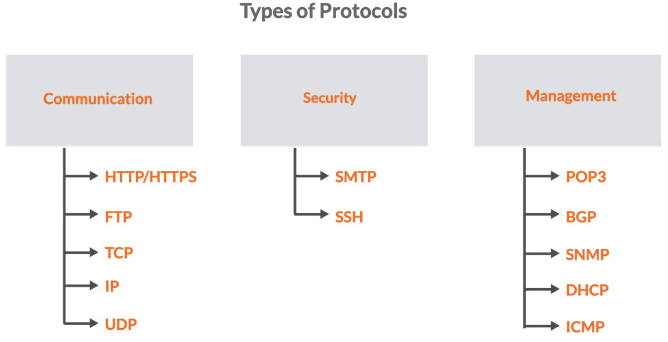
Protocols Of IoT (Cont’s)
4
Communication Technology Of IoT
Notes:
https://geekflare.com/guide/common-network-protocols/
https://geekflare.com/wp-content/uploads/2023/10/types-of-protocols-1200x616.png

Slide 5
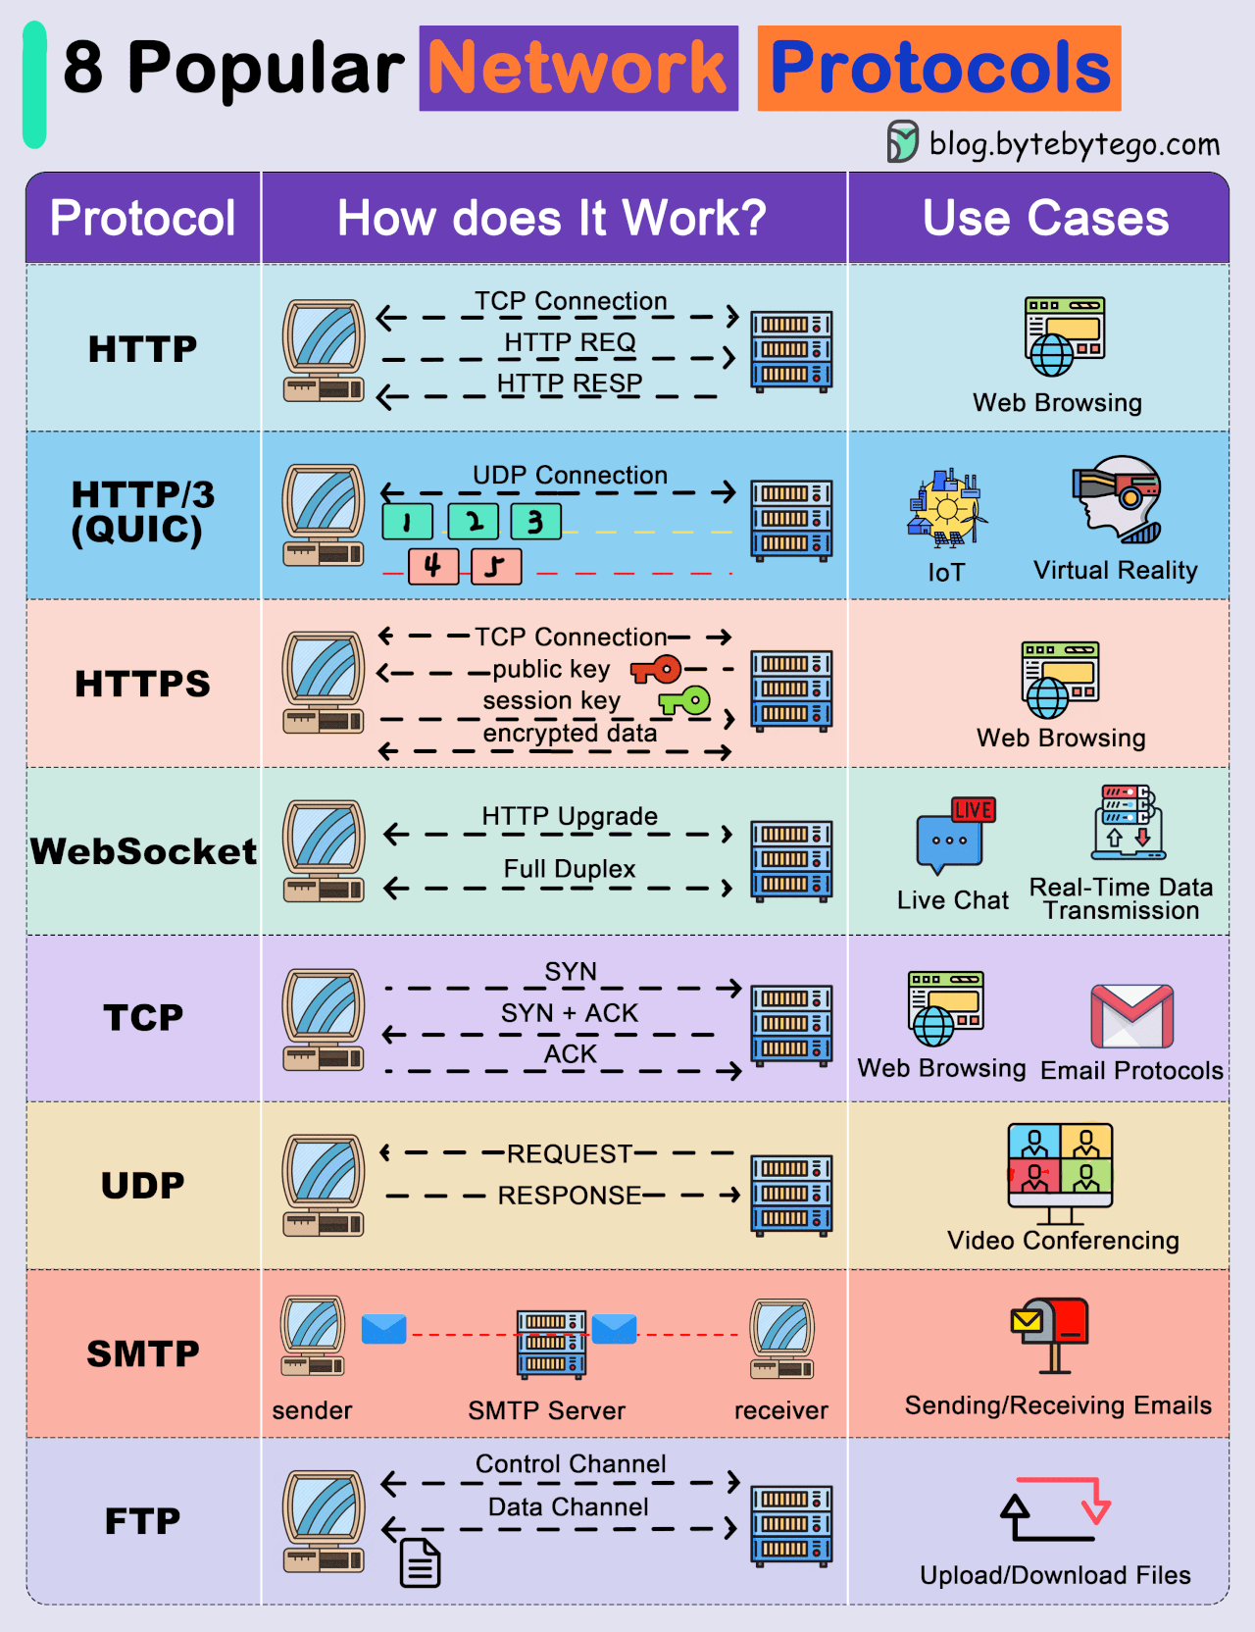
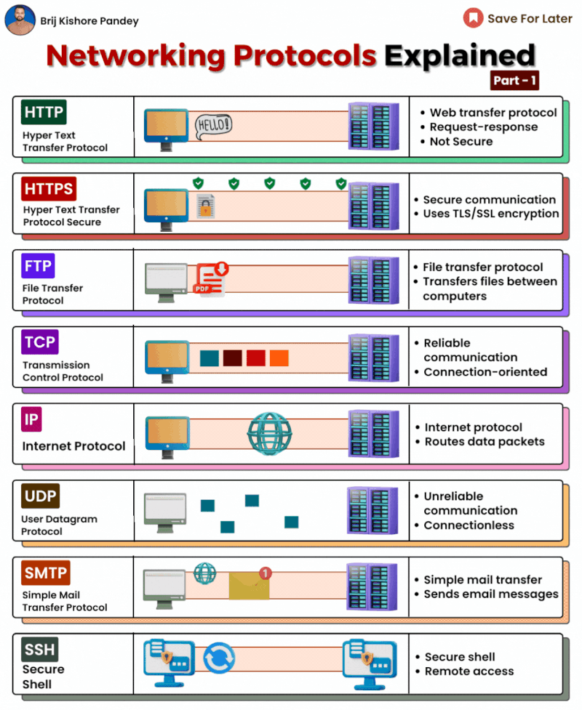
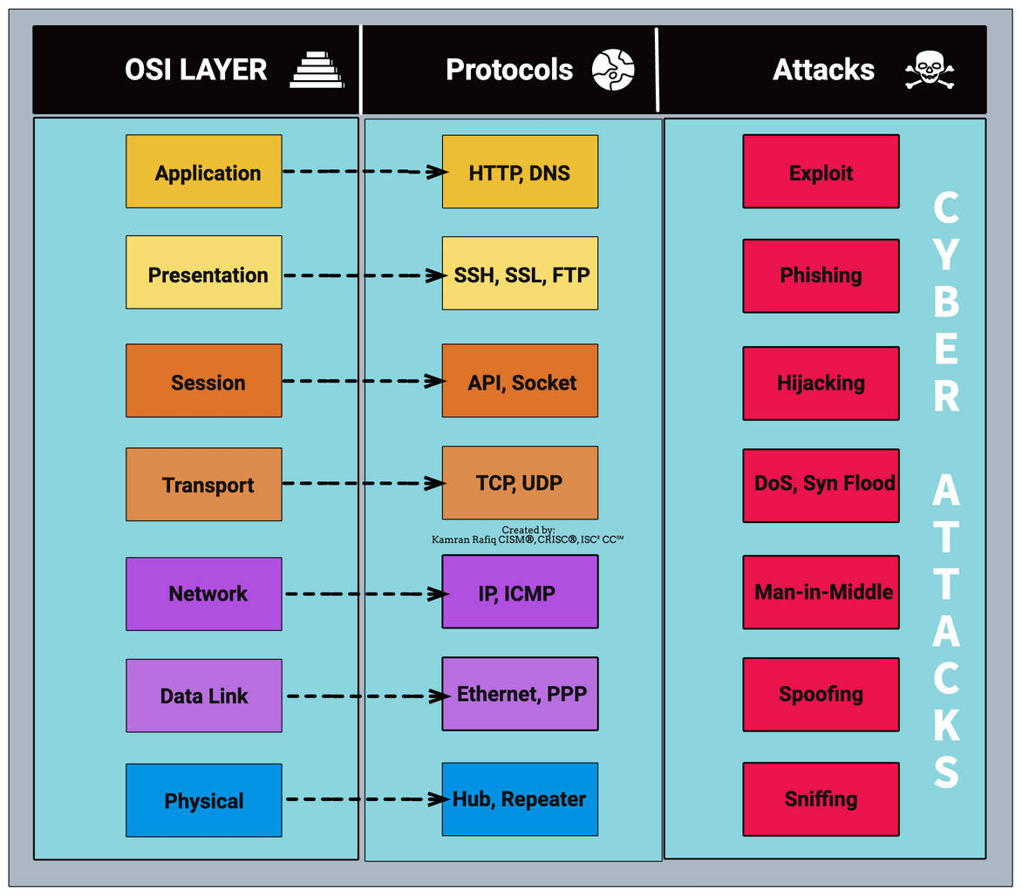
4
Protocols Of IoT (Cont’s)
The IoT Ecosystem: Sensor Device &Components, Architecture, Communication Technologies, and Protocols
Network Protocols
Notes:
https://geekflare.com/guide/common-network-protocols/
https://kamranrafiq12.medium.com/simple-illustration-of-the-osi-model-and-cyber-attacks-at-each-layer-7cdc6cf66fda
https://levelup.gitconnected.com/a-developers-guide-to-network-protocols-851a3cb3b702
This guide will cover these sections:
HTTP (Hypertext Transfer Protocol)
Introduction to QUIC
HTTPS (HTTP Secure)
WebSocket
TCP (Transmission Control Protocol)
UDP (User Datagram Protocol)
SMTP (Simple Mail Transfer Protocol)
FTP (File Transfer Protocol)

Slide 6
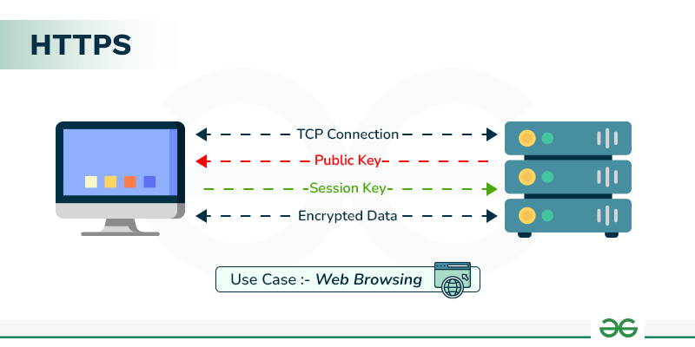
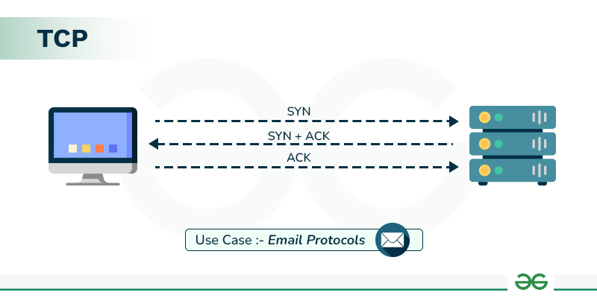
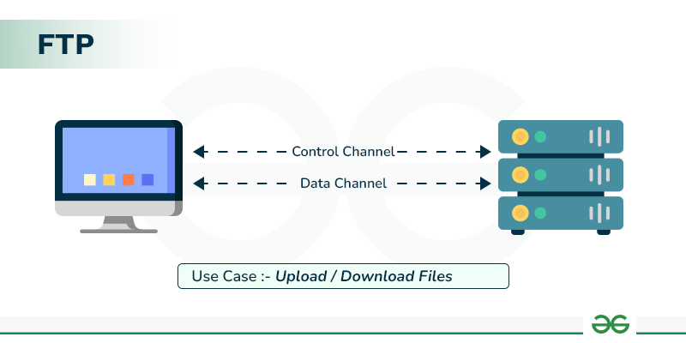
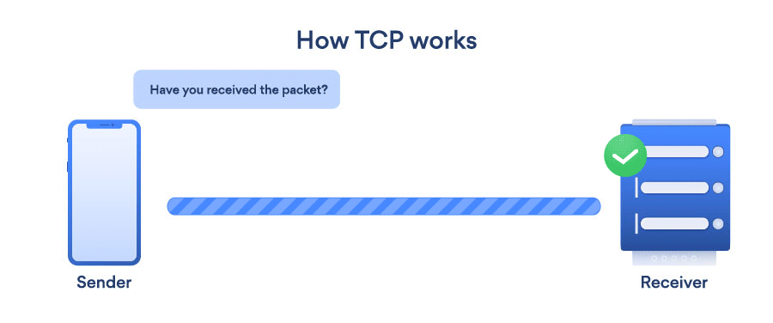
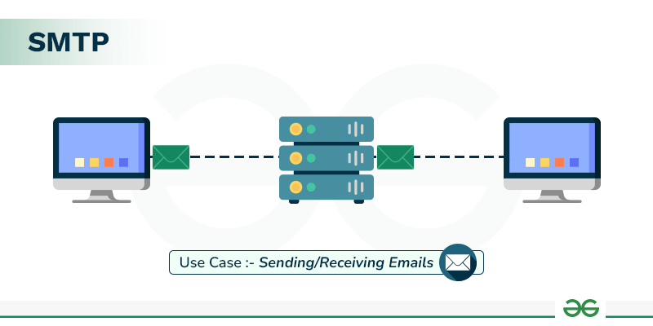
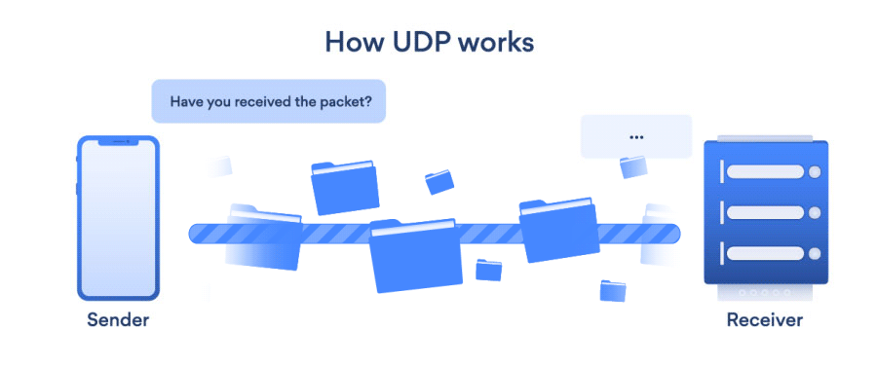
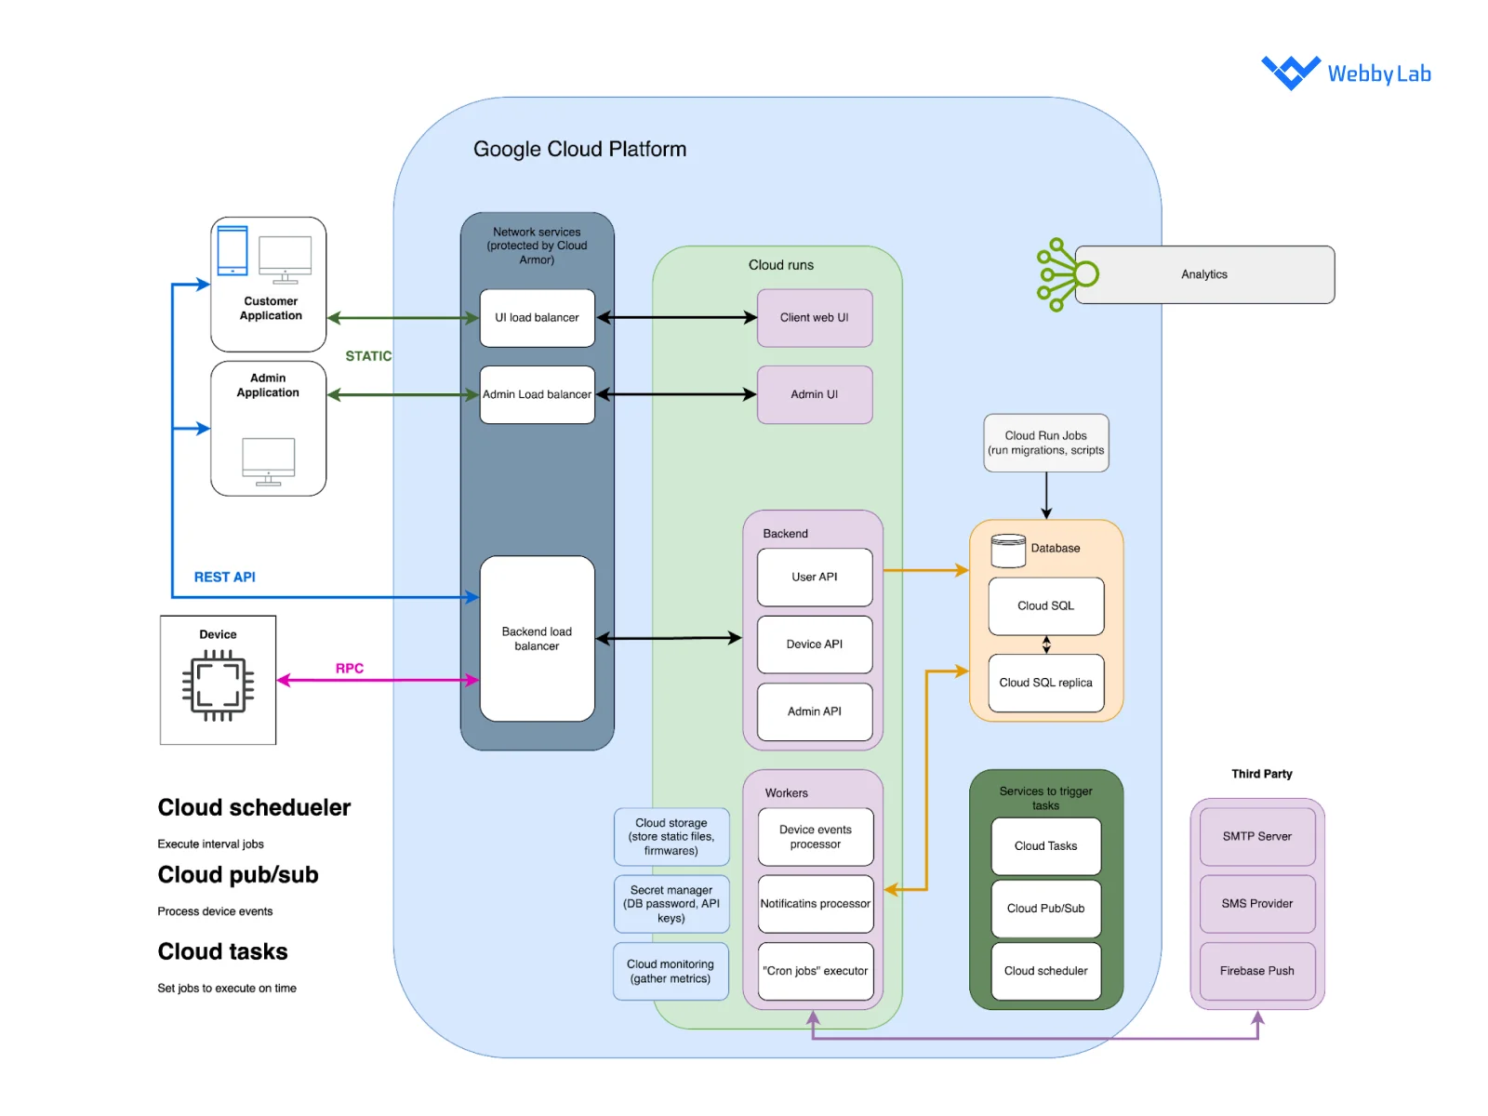
Protocols Of IoT
Network Protocols
Notes:
https://in.pinterest.com/pin/9570217952435876/
https://webbylab.com/blog/iot-architecture/
https://cloud.google.com/architecture/connected-devices/iot-platform-product-architecture?hl=id

Slide 7
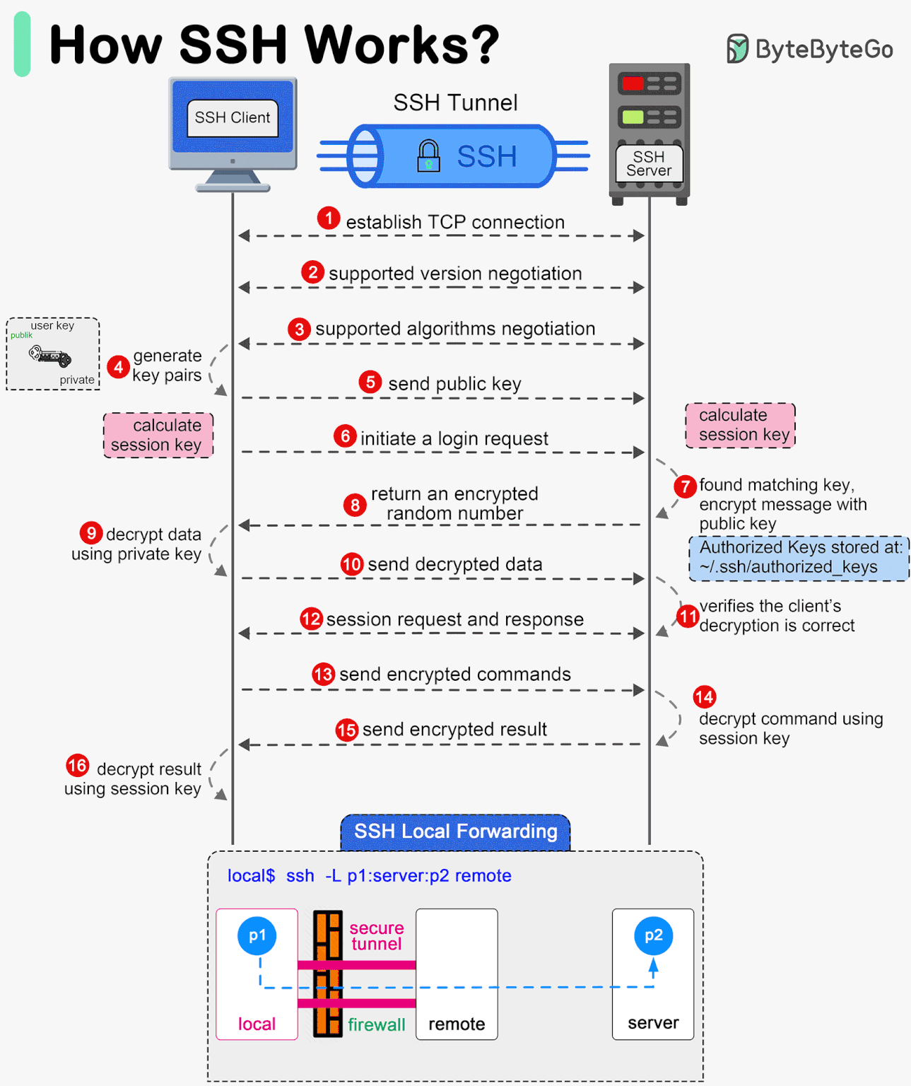
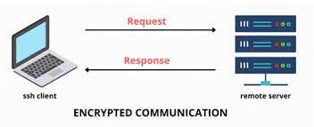
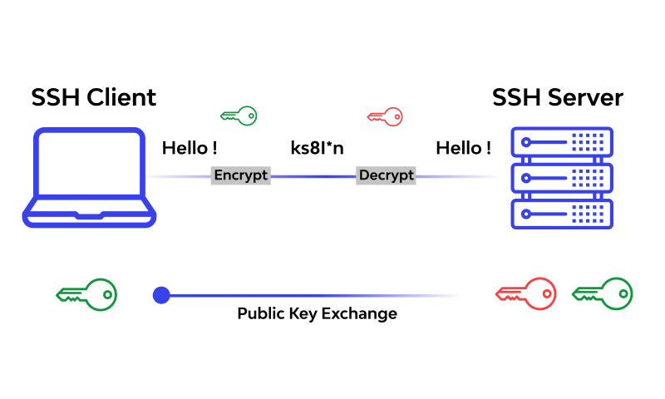
Protocols Of IoT (Cont’s)
ssh
Notes:
https://geekflare.com/wp-content/uploads/2023/10/types-of-protocols-1200x616.png

Slide 8
Thank you!
PDS
Computer Vision
Next >>> Chap2_IoT Ecosystem_Part1-3
Q&A
Thank you For being a great class!
https://github.com/siagianp
https://www.youtube.com/@AmelOline/videos
https://github.com/amelcharolinesgn2/IoT_simulator-mqtt-NodeRed
https://github.com/amelcharolinesgn2/Cloud-Infrastructures
https://github.com/amelcharolinesgn2/ClouD-Infrastructure-SISKA-2025
Notes:
https://medium.com/buildpiper/simplifying-containerization-with-docker-run-command-2f74e114f42a
https://github.com/IBA-Group-IT/IoT-data-simulator
https://www.bevywise.com/blog/docker-mqtt-broker-easy-service-manageability/

